Slide 1
Radiology Case Series General Surgery Clerkship
Prof Dr Koray Güven
Radiology and Interventional Radiology
Acıbadem MAA University

Slide 2
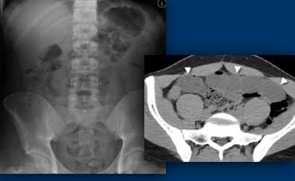
Tools
Basic
Available
Simple
Superposition
Interpretation
Radiation
X-ray
Ultrasonography
Computed Tomography
MRI
Angiography

Slide 3
Tools
Simple
No Radiation
Good for solid organs, vessels
Gas, bones
Operator dependent
X-ray
Ultrasonography
Computed Tomography
MRI
Angiography

Slide 4
Tools
Solid organs, intestines, lungs
Cross sectional, no superposition
Good for organs and vessels
Contrast usage
Radiation
Availability!
Interpretation
X-ray
Ultrasonography
Computed Tomography
MRI
Angiography

Slide 5
Tools
Good for soft tissue resolution
Functional and morphologic data
Solid organs, vessels
No radiation
Artifacts
Not good for emergent situation!
Expensive
Availability
X-ray
Ultrasonography
Computed Tomography
MRI
Angiography

Slide 6
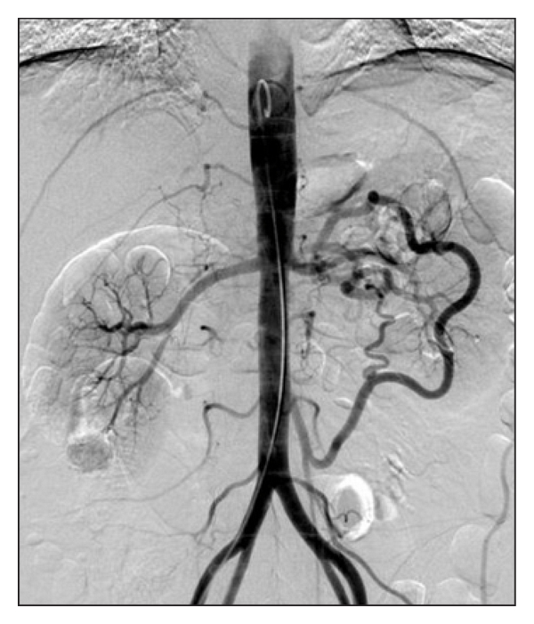
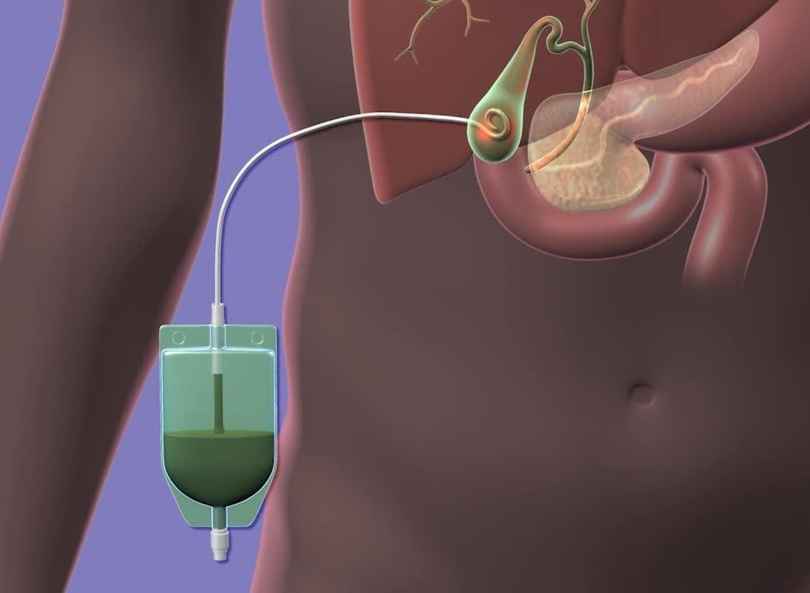
Tools
Best friend of general surgeon ☺
Good for vessels
Trauma, bleeding
Minimal invasive
Availability
Expensive equipment
Personnel
Radiation !
X-ray
Ultrasonography
Computed Tomography
MRI
Angiography-IR

Slide 7
Case 1
Which radiological examination?
Why?
Differential diagnosis?
45 y M, Right upper quadrant pain radiating to both lomber area
Fever?, Nausea, no pain in urination
Leukocytosis, CRP high, elevated liver enzymes

Slide 8
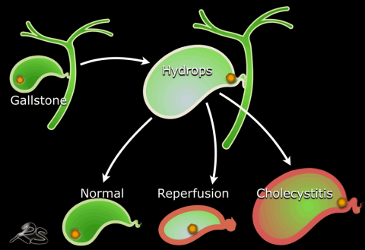
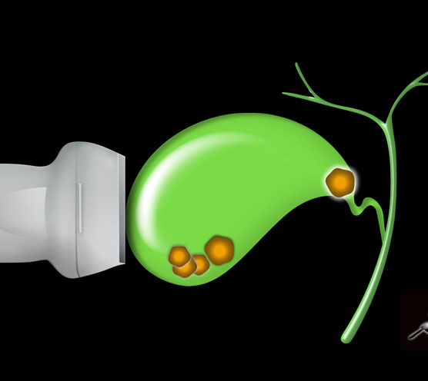
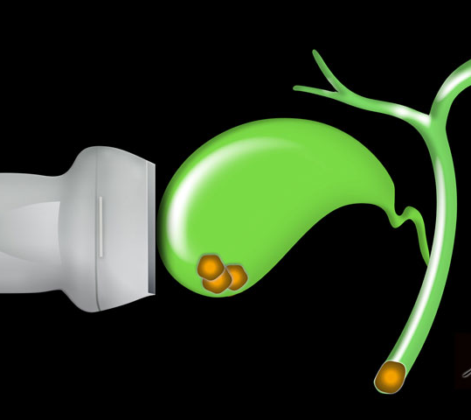
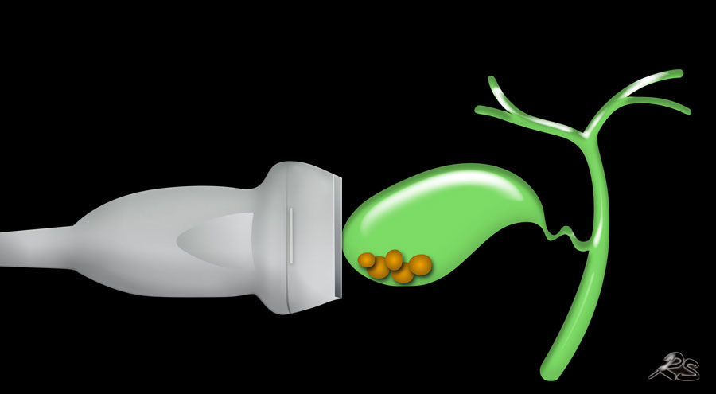
Gallstone/Cholecystitis
Thickening of gall bladder wall
Stones or sludge
Hydrops
’Murphy sign’
Dilatation of IHBD/EHBD
Pericholecystic fluid

Slide 9
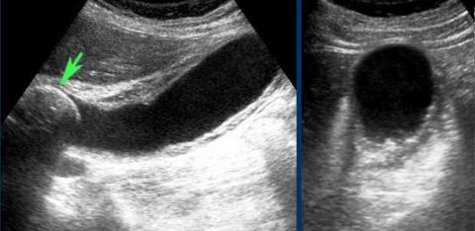
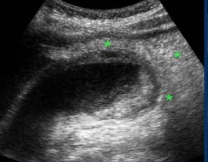
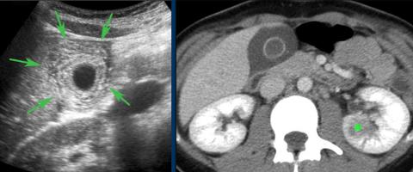
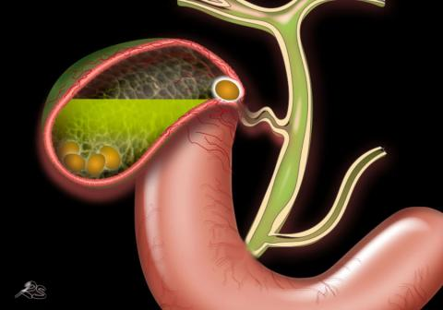

Slide 10
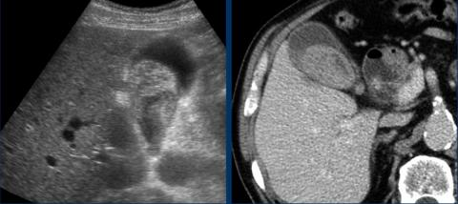
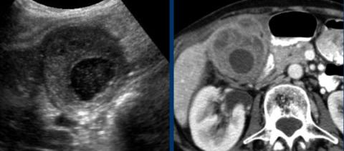
Acalculous cholecystitis
Mirizzi Syndrome
Malignancy
Abcess
Fistulization
Hemorrhagic cholecystitis
Xanthogranulomatous cholecystitis
Percutaneous cholcystostomy

Slide 11
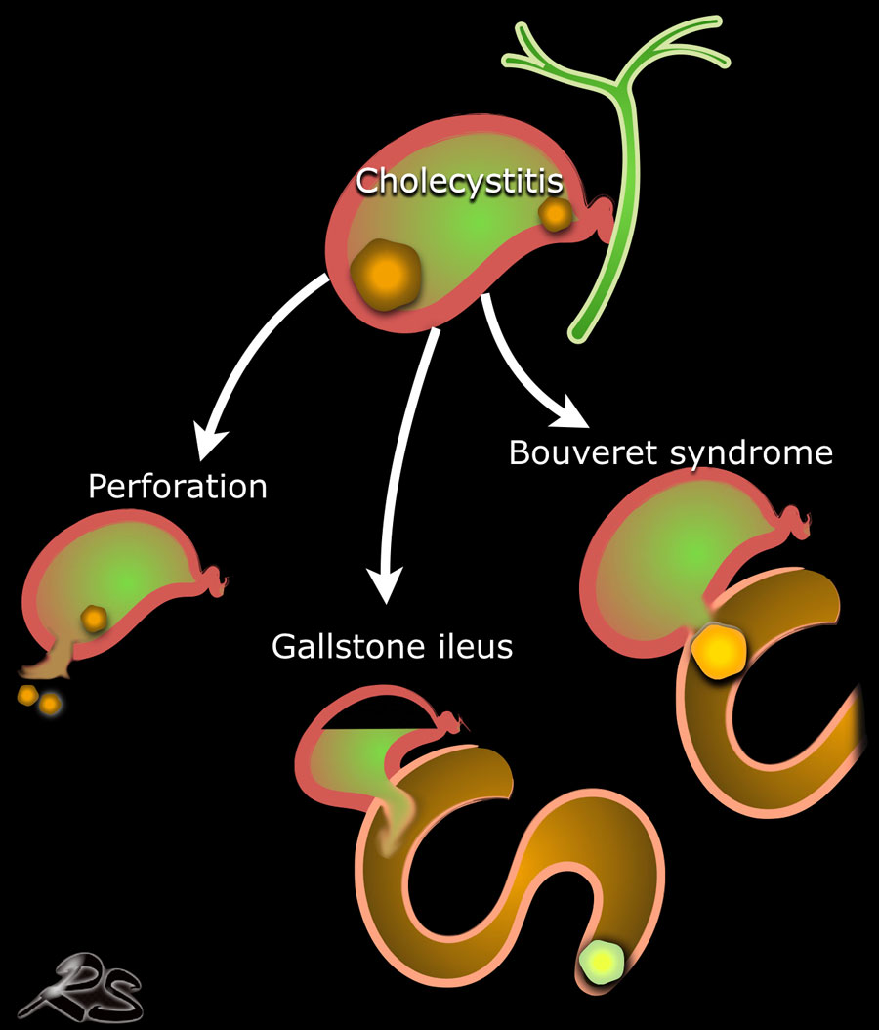
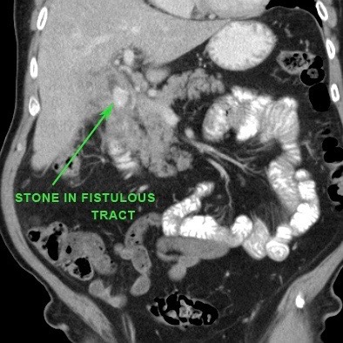

Slide 12
Case 2
Which radiological examination?
Why?
Differential diagnosis?
33 y F, Right lower quadrant pain radiating to umbilical area
No fever, Nausea, no pain in urination
Leukocytosis, CRP high

Slide 13
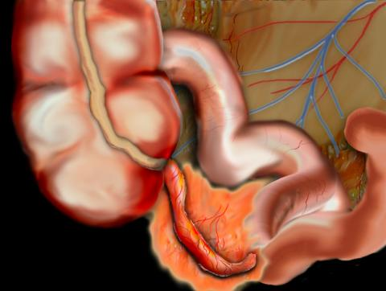
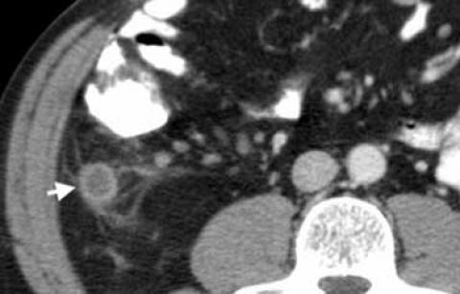
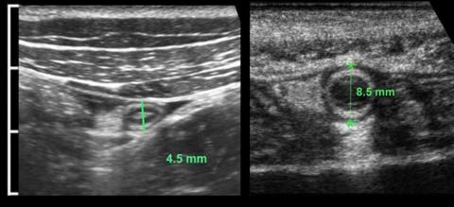
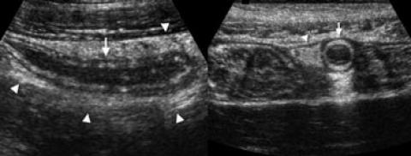

Slide 14
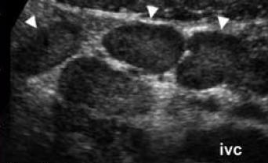
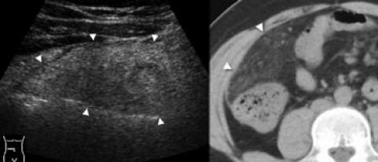
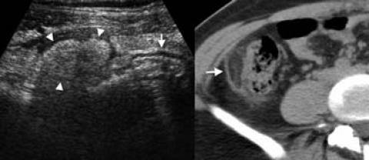
Differential Acute Appendicitis
Mesenteric lenfadenitis
Crohn
Gynecologic conditions
Urolithiasis
Diverticulitis
Malignancy
Hematoma
…
Omental infarction
Epiploic appendigitis

Slide 15
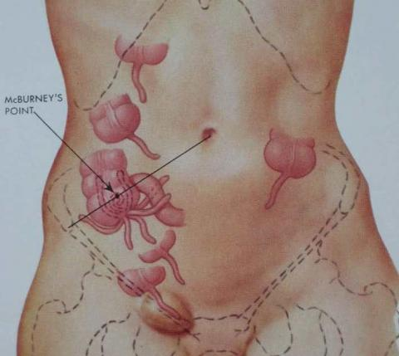
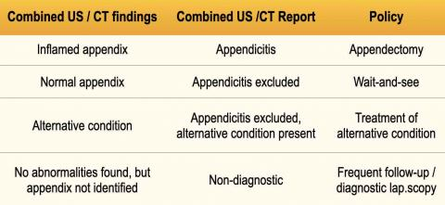

Slide 16
Case 3
Which radiological examination?
Why?
Differential diagnosis?
56y M, Severe epigastiric pain radiating to umbilical and lumbar area
fever, nausea, no pain in urination
Leukocytosis, CRP high, elevated liver and pancreatic enzymes

Slide 17
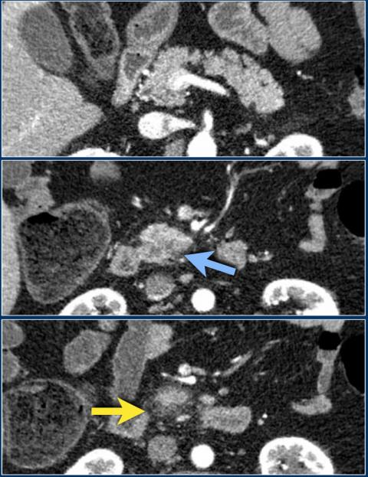

Slide 18
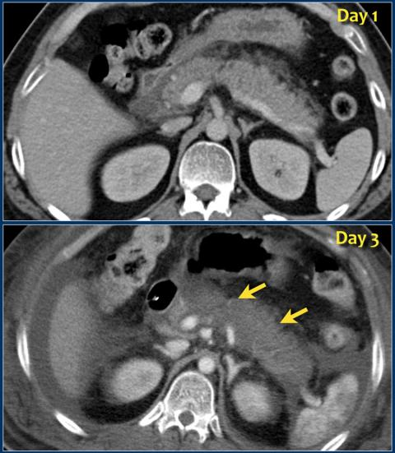
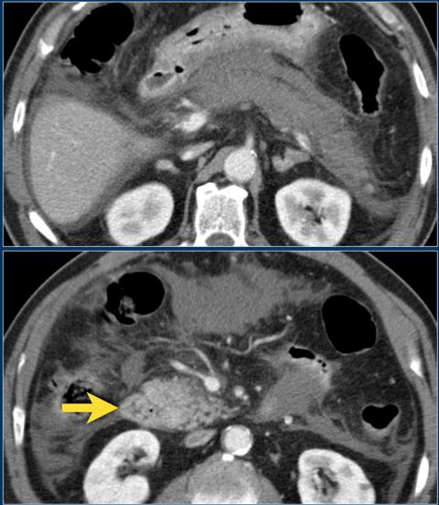

Slide 19
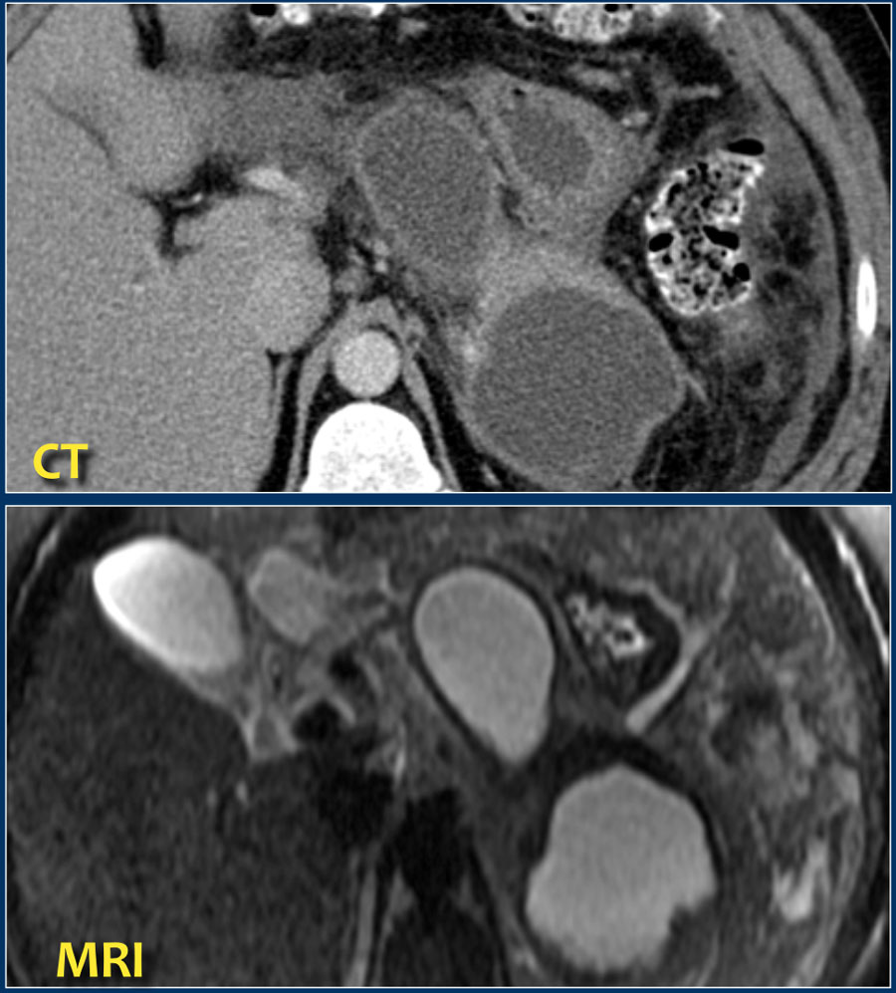

Slide 22
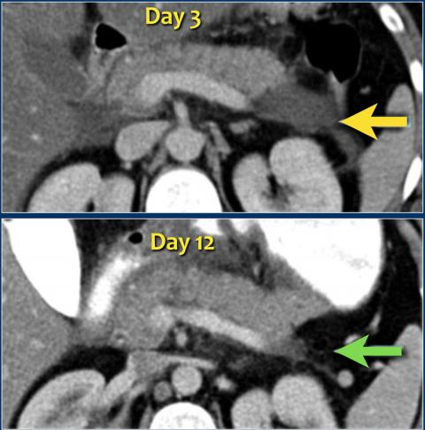
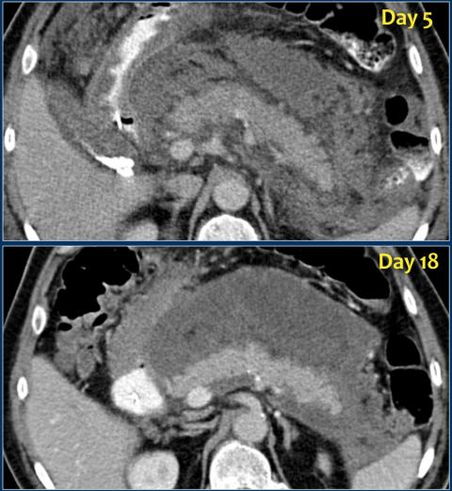

Slide 23
